Slide 1
Pre-Placement Talk
June 2021

Slide 2
01
About Us
02
Working With Us
03
Our Process
Table of
Contents

Slide 3





About Think360
Helping businesses drive forward with ideas powered by data and artificial intelligence
2014
WE STARTED
50+
CLIENTS SERVED
20+
PRODUCTS & ACCELERATORS
80+
PROJECTS DELIVERED
100+
OUR TEAM
2+
INDUSTRIES WE SERVE

Slide 4

Our core values
Client Centricity
Work Smartly
Focus on solving client’s business problem
Increase efficiency through automation, and intelligence
Intellectual Curiosity
Collaborative
Be curious to learn more and new stuff
Collaborative within team and with client

Slide 5
We work across AI lifecycle
Data Engineering and Data Ops
Quant and Modeling
Applications and Automation
Ingest data sources, build and manage data infrastructure
Solve complex business problems by leveraging best-in-class quantitative algorithms and business frameworks
Take innovation to the outposts; Implement and democratize AI by building applications used widely across organizations

Slide 6






































We work with marque clients across financial services and other industries
Financial Services Clients (non-exhaustive)
Other Clients (non-exhaustive)
Banks
NBFC & Other FIs
Fintechs

Slide 7


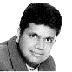


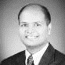
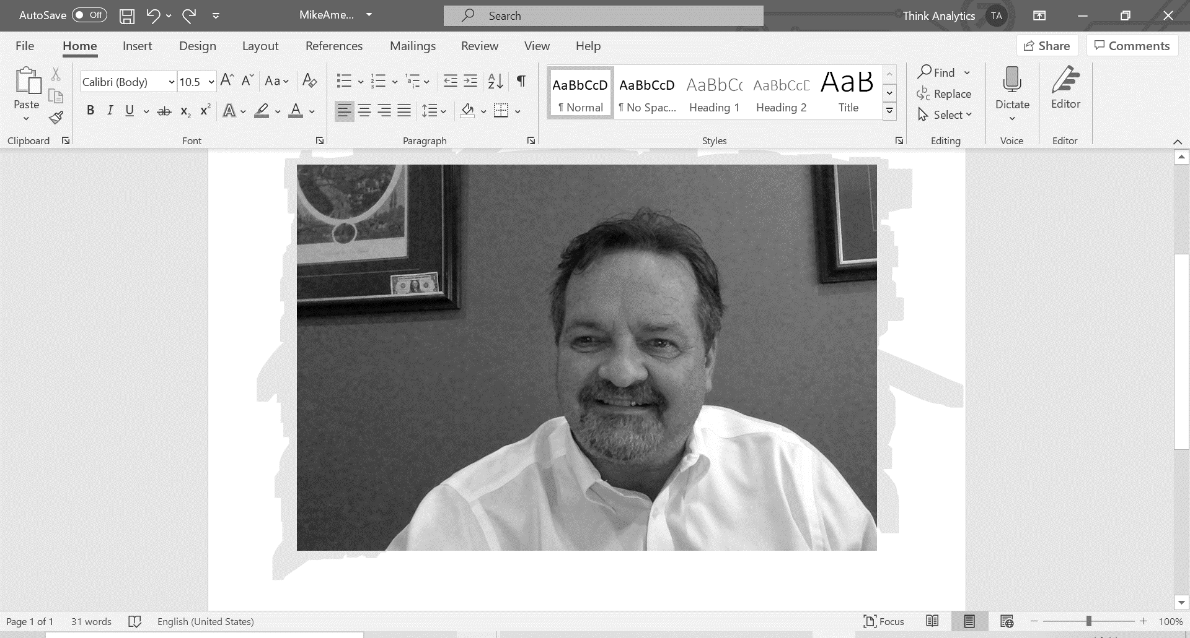

Our leadership team is made of industry veterans
17+ years
PwC, Diamond Consultants, 3i Infotech, Inductis (EXL Services), TCS
IIM Bangalore, DU (Econ)
15+ years
FICO, PwC, Diamond Consultants
IGIDR (MSc Econ), University of Calcutta (Econ)
11+ years
3i Infotech, L&T Infotech, Weight Watchers
Hofstra Univ, KJ Somaiya (CS)
Amit Das
CEO
Suryadip Ghoshal
Chief Analytics Officer
Monish Salot
Chief Product Officer
21+ years
Microsoft, GE Energy, Neal Analytics ++
BE Comp Sc (Pune University)
17+ years
Bharti Airtel, KritiKal
IIM Bangalore, IIT Delhi
21+ years
Mphasis, Sapient, Siemens, GE Healthcare
ISB Hyderabad
Ajay Solanki
CTO
Sarin Suares
CFO
Anupam Chandra
COO
35+ years
IBM, Oracle, Compuware, Digite
BA (University of Cincinnati)
15+ years
Experian, EY, ICICI, Inductis
MDI Gurgaon
Michael Amend
Vice President, Solutions - Americas
Neha Swetambari
VP – Risk

Slide 8


































Our services team solves complicated business problems through technology and analytics
We solve high impact problems using analytics
We use advanced analytics, data management frameworks, machine learning algorithms, and custom applications
Analysis and Modelling
Visualization
Application Development
Data Management
Cloud Management & Orchestration
Cloud Infrastructure

Slide 9


Our products are focused on reducing friction for lenders
ALGO360
Kwik
Largest alternate credit score and data enrichment solution in India with 40 mn+ scores, 10,000+ features per customer leveraging alternate data
Cutting-edge video engagement product for customer onboarding and assisted activities, e.g., agent-assisted conversations, identity check (KYC), (+identity risk management, facial recognition, OCR personalization)

Slide 10
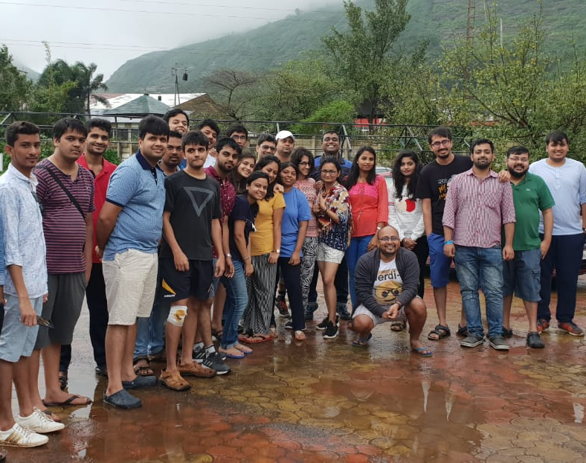
Why Work with Us?
High impact projects
High exposure to business problems and processes – high client exposure
Covid Measures
Normal increment and bonus cycle – no Covid impact
Work from home from March 2020 onwards
Reimbursement for setting up home office
Health Insurance
Extra leaves to take care of self and family
Mental health sessions
In better times, we have quarterly outings and annual offsites

Slide 11
Team members we are looking for
Fullstack Designer
Data Analyst
Data/ Software Engineer
Note: JD Already Shared

Slide 12
Our Interview Process
There will be 2 – 3 rounds of interviews for successful candidates.
You can expect questions on coding, problem solving, business case studies, puzzles and guesstimates.

Slide 13
Salary & Benefits
Salary Component | Annual Amount (INR)
Fixed Component | 6,00,000.00
Performance Bonus | 1,00,000.00
Joining Bonus | 50,000.00
Provident Fund | 21,600.00
CTC | 7,71,600.00
Additional Reimbursements for Phone, Internet, Late night expenses and Learning Allowance
Annual Potential Performance Bonus will be as per the annual review policies set by the management and will be reflection of your individual as well as company performance

Slide 14
THANK YOU

